Slide 1


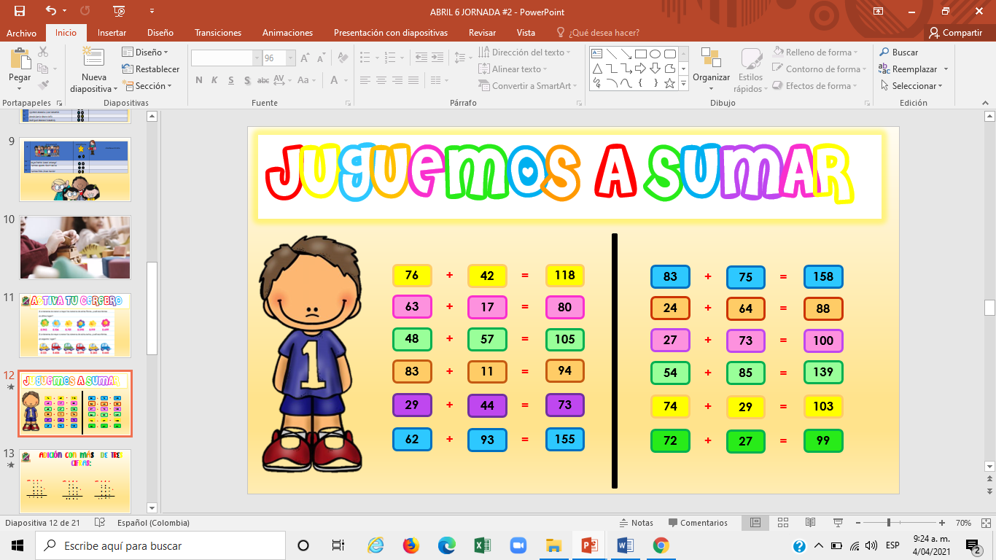

Slide 2
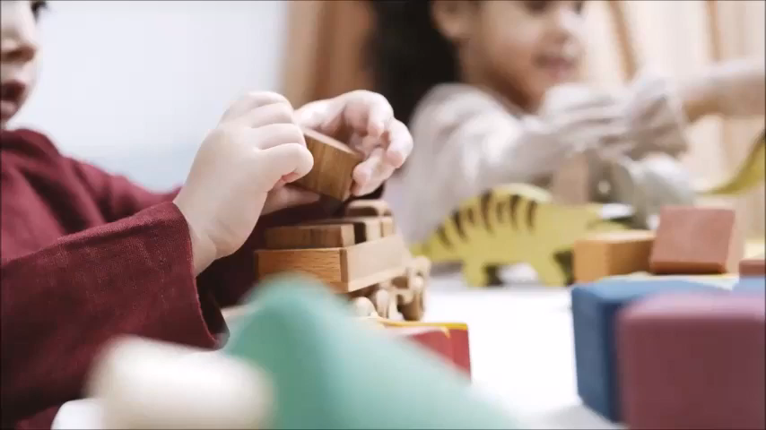

Slide 3
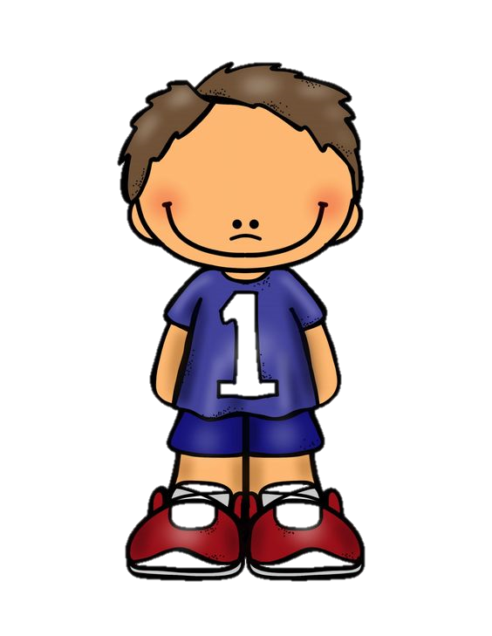
76
+
42
=
118
83
+
75
=
158
63
+
17
=
80
24
+
64
=
88
48
+
57
=
105
27
+
73
=
100
83
+
11
=
94
54
+
85
=
139
29
+
44
=
73
74
+
29
=
103
62
+
93
=
155
72
+
27
=
99

Slide 4


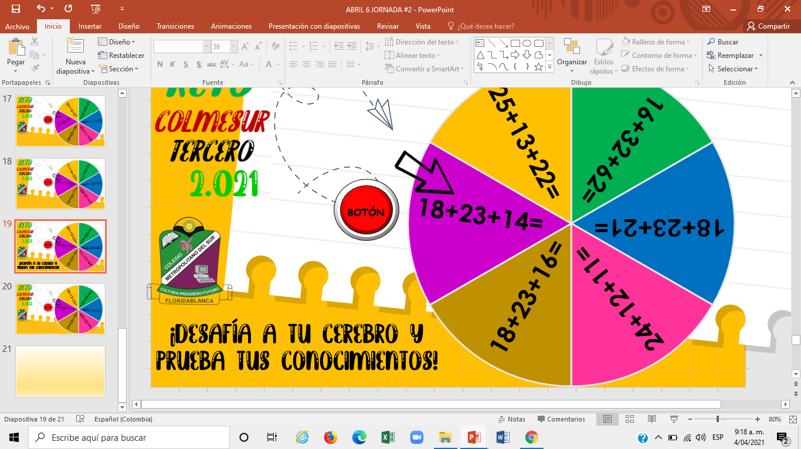
35+12+27
17+32+27=
Botón
12+5+3=
27+11+42=
18+22+14=
25+11+52=

Slide 5
11+16+23=
12+26+71=
17+11+12=
16+21+31=
Botón
12+16+71=
17+10+42=

Slide 6

25+13+22=
16+32+62=
18+23+14=
Botón
18+23+21=
18+23+16=
24+12+11=

Slide 7
18+13+32=
19+23+31=
11+35+71=
Botón
22+3´+52=
19+23+18=
16+32+62=

Slide 8
